Slide 1

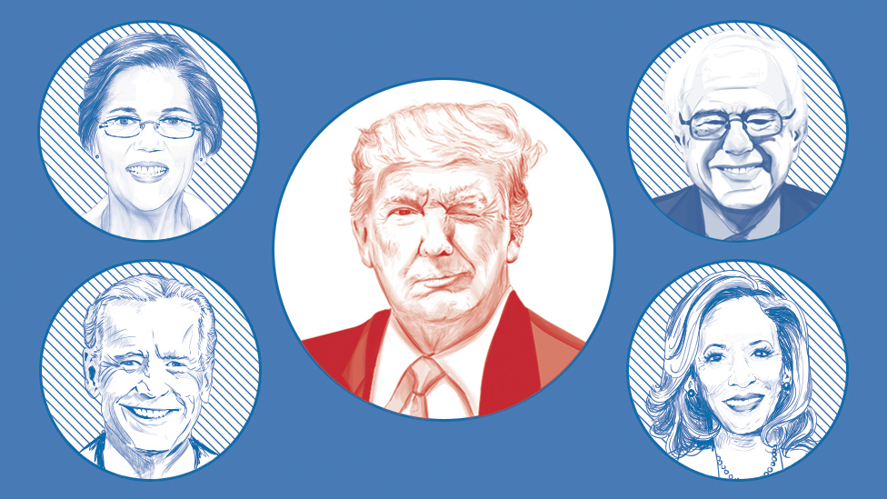
Twitter and Politics
Dandi Chen | Matthew Peng | Truett Bloxsom | Mohammed Saqib | Yuke Liu

Slide 2

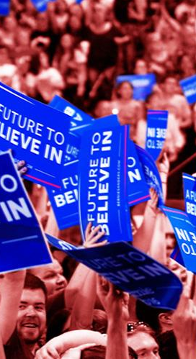
Overview
1
Intro
2
Data Source
3
Candidate Analysis
4
Policy Analysis
5
Recommendations

Slide 3
1
Introduction

Slide 4
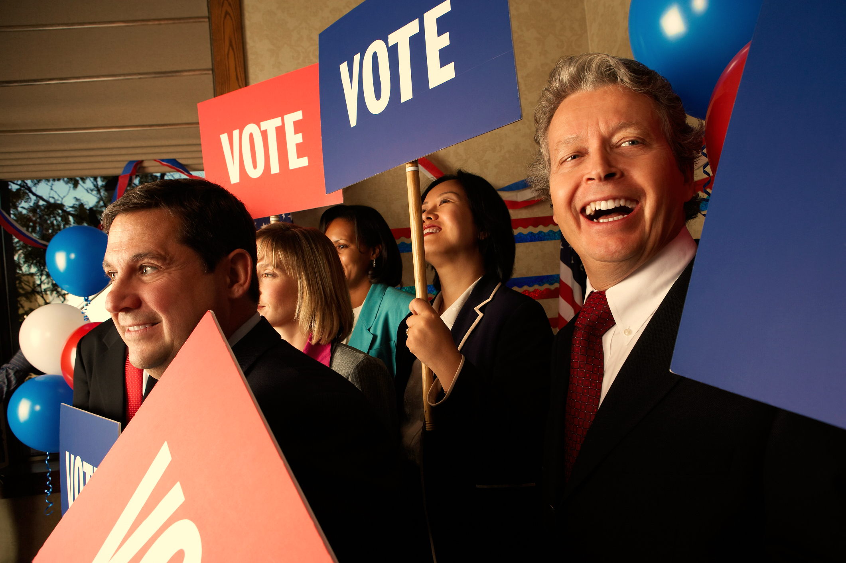
Problem
Statement
Is my campaign strategy working?

Slide 5
Approach
Comparison between media outlets
Identify Campaign Platforms (strategies)
candidates’ websites, news report
Conducted qualitative research on candidates’ websites and identify their policy preferences as well as campaign strategies
Assess Campaign Execution (efforts)
tweets from seven news agencies
Conducted lift analysis and sentiment analysis on the campaign strategies identified
Assess Crowd Opinion (results)
tweets searched by democrats related keywords
Conducted lift analysis and sentiment analysis on the campaign strategies identified
Notes:
the big idea: good strategy requires good execution/action to gain good results. If you have good strategy but poor execution, it’s very unlikely you will get good results.
id campaign platform:
news data: Candidates use press conference, press release and interviews to gain exposure on the news to convey the image they want to build in the public’s mind. Thus, we think that by conducting lift analysis and sentiment analysis, we can assess how well are their executions.
twitter : crowd response
https://www.thebalancecareers.com/how-politicians-use-media-to-win-elections-2315204

Slide 6
2
Data Source

Slide 7

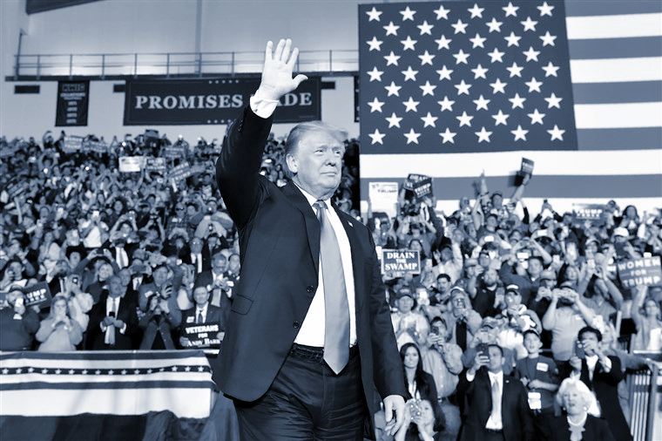







Twitter Data
democratic primaries
presidential debate
Democratic Presidential Candidate
Democratic Presidential Candidates
Democratic President Candidate
Democratic President Candidates
News Data
Notes:
We Scraped Twitter data from the crowd and the news
We got 17,000 crowd tweets and 25,000 news tweets
from August to November 2019

Slide 8
3
Candidate Analysis

Slide 9
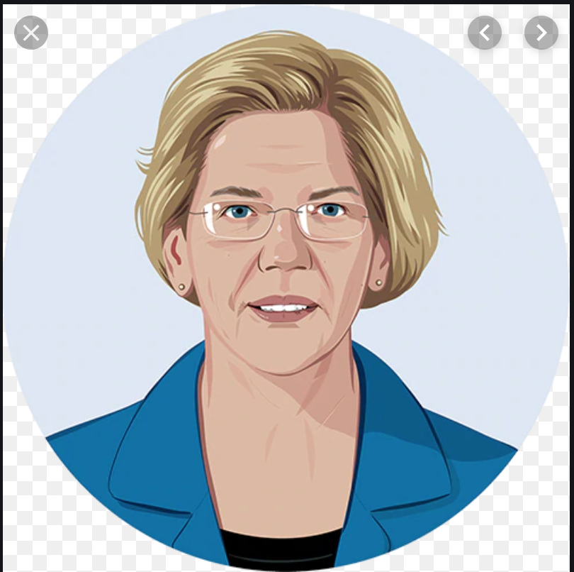
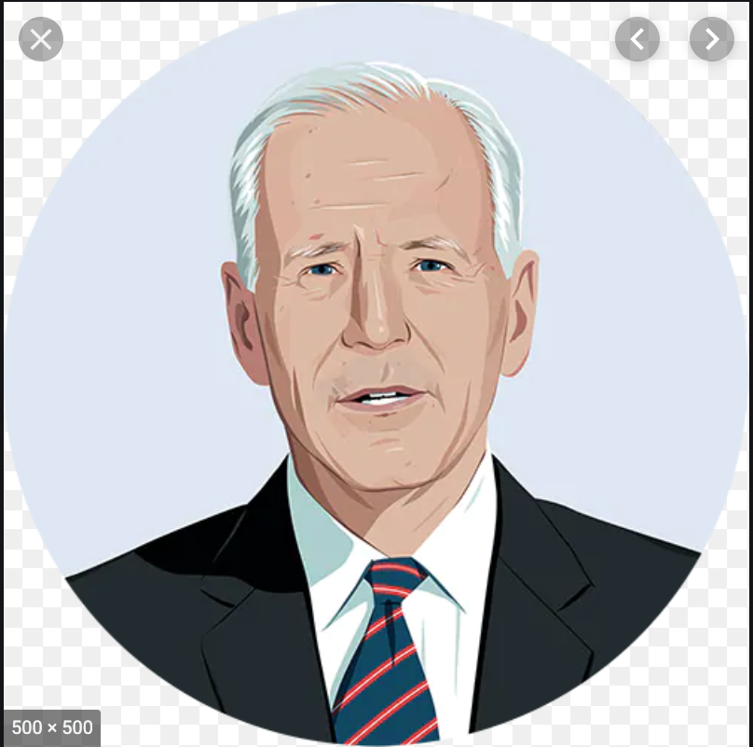
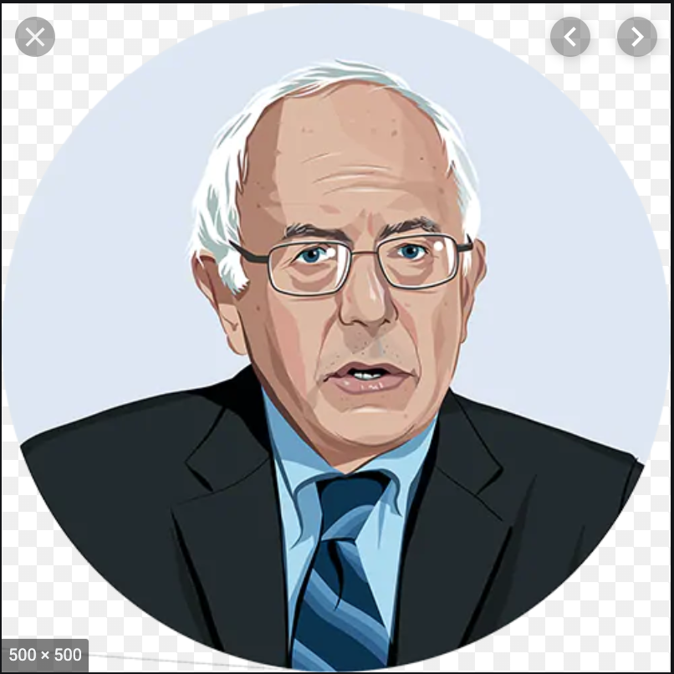
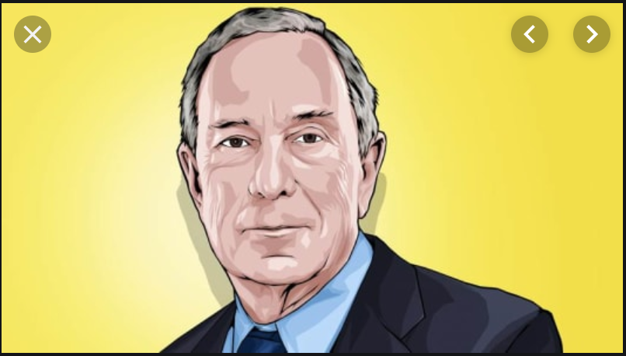

Candidate Overview
Elizabeth Warren
Joe
Biden
Bernie
Sanders
Michael
Bloomberg
Senator For Massachusetts since 2012
69 Years Old
10 Years in politics
Former Vice President, Senator of Delaware
76 Years Old
49 Years in politics
Senator for Vermont, 2016 Presidential Candidate
77 Years Old
38 Years in politics
Former Mayor of New York City, Founder of Bloomberg L.P.
76 Years Old
18 Years in politics
Social Media:
Twitter: 4.8 M
Facebook: 3.2 M Instagram: 1.3 M
Social Media:
Twitter: 3.6 M
Facebook: 1.49 M
Instagram: 1.3 M
Social Media:
Twitter: 8.1 M
Facebook: 7.5 M
Instagram: 2.9 M
Social Media:
Twitter: 2.3 M Facebook: 756,400
Instagram: 202,000
Notes:
Talk about why we focus on these 4 candidates
Top 3 in most polls
Bloomberg as an unexpected candidates
Point out (1) Sanders has high exposure on social media
(2) Joe Biden has low exposure on social media (later you will see nobody talks about his policies on twitter )

Slide 10
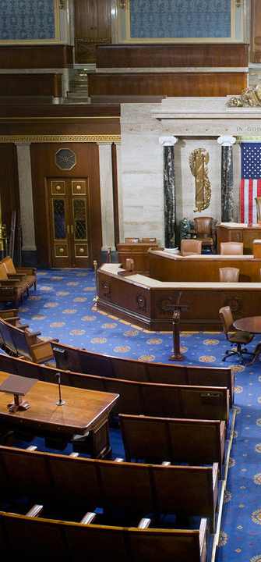
General Candidate Analysis
Experience
Popular
Unpopular
Positive
Bloomberg
News
Neutral
Sanders
Biden
Biden
Negative
Bloomberg
Tweets
Sanders
Biden
Positive
Biden
Notes:
Biden is not tweeting enough
Democratic socialist, more crowded funded. has is the most liked politician
flopper

Slide 11
4
Policy Analysis

Slide 12
Elizabeth Warren
Top Agendas
Tax
Strengthen democracy
Women’s rights
Education
News Sentiment
Education
Taxes
Health
Social
Women’s Rights
Tweets Sentiment
Education
Taxes
Health
Social
Women’s Rights
Notes:
Let’s start with Elizabeth Warren. In her campaign she has focused on taxing the ultra wealthy, women's rights, and cancel student loan debt. Lets compare what the news and people think about her policies. Both the News media and twitter dislike her stance on education. Both The new media and twitter like her stances on taxes and health related topics. People support her views on family matters but the news media did not bring up this issue. The most interesting thing is that people seem to dislike her stance on women’s rights which include: being pro-choice, increasing funding for affordable birth control, and pushing for equal pay. Again, there is no talk of warren and women’s rights in the media.

Slide 13
Joe Biden
Top Agendas
Health
Criminal Justice
Social Equality
Climate
News Sentiment
Education
Jobs
Health
Social
Poverty
Criminal Justice
Tweets Sentiment
Education
Jobs
Health
Social
Poverty
Criminal Justice
Notes:
For joe biden, his platform mainly consists of protecting obamacare, reform the criminal justice system which includes reducing the disproportionate amount of minorities in prison, and passing legislation to combat climate change. From the Media, Joe seems to be doing alright: the media tends to support his views and actions on education, jobs, and healthcare, but dislike his views/actions on social policies and poverty. But the big takeaway here is that the people don’t care about him at least in terms of his policies. The only policy that people are talking about and dislike about him is his stance on the criminal justice system. This is most likely because of his history of being incredibly tough on crime and wanting to escalate the war on drugs in the 80’s and 90’s.

Slide 14
Bernie Sanders
Top Agendas
Expand social security
Immigration reforms
Health and medicare
Education
News Sentiment
Education
Taxes
Jobs
Health
Climate
Immigration
Democracy
Tweets Sentiment
Education
Taxes
Jobs
Health
Climate
Immigration
Democracy
Notes:
Bernie Sanders: (TAX++,Healthcare+0,Climate--)
We know that Bernie is a democratic socialist and a progressive. One of the top policies of Bernie is to establish an tax program on the extreme wealth i.e, top 0.1 percent of U.S. households. The good thing is, both the news and the twitter have a positive sentiment on this stance and feels he is doing the right thing.
Regarding health, he has plans to introduce medicare for all with no premiums and no surprise bills. He also plans to eliminate about $81b of medical debt.
The good thing is the news likes his stance on health. But, still the twitter has a neutral standpoint regarding Bernie on health.
One red flag for Bernie is that the news channels and the twitter has a -ve sentiment on Bernie regarding climate. Even though one of his top agenda is to introduce a green new deal and shifting to 100% renewable energy.

Slide 15
Mike Bloomberg
Top Agendas
Jobs (strengthen mid-class)
Health (medicare)
Immigration
Equal rights (LGBT)
News Sentiment
Taxes
Jobs
Climate
LGBTQ
Tweets Sentiment
Taxes
Jobs
Climate
LGBTQ
Notes:
Michael Bloomberg:
One of the richest person in the world entered the picture a bit late, but has all the money ammunition to help him succeed.
Some of his top agendas atleast according to him is to strengthen the middle class by creating more jobs and expanding the obamacare and the medicare.
Looking at the twitter world, it doesn’t like Bloomberg as much as the other candidates. They have a negative sentiment on him regarding Taxes, Jobs, and climate. People might be of the opinion that he won’t raise taxes on the wealthy. But, the only positive sentiment on twitter on Bloomberg is regarding the LGBTQ community. Even though he has a mixed LGBTQ record.
One interesting thing is that the news channels have a positive sentiment regarding bloomberg on taxes. One of the first thing that pops up during his campaign advertisement is his agenda of rising the taxes on the wealthy. So he has that going for him.

Slide 16
5
Recommendations

Slide 17
Recommendation
Speak up about topics other than Women’s rights
More modest plan for Education
Be more active on social media
Switch the campaign focus from criminal justice to jobs
Notes:
Warren: negative in women’s rights n education
after researching, we found through polling result that women’s right is not a big concern for voters. So we think that the reason why warren has has negative sentiment on twitter is because the group of very liberal women does not like her modest view. But since women’s rights is not a big issue among general voters and negative sentiment might not be fixable. so she should focus on other topics that brings her positive sentiment such as tax and healthcare.
Education is one of the most important topics for voters. However, it’s not as important as topics such as healthcare and the economics. Warren expressed that she want to reform the k-12 system. This plan is very ambitious however, it lacks clear frameworks and it seems to be too ambitious for the voters. So we recommend that Warren come up with a more modest plan for education
Biden:
As Biden has low association(lift) with most of the topics such as Education, job, health and social. So we would recommend him to be active on social media and increase inluence on social media
Switch the campaign focus from criminal justice to jobs since he is the only candiate with positive sentiment for jobs in the news data

Slide 18
Recommendation
Talk more about the Green New Deal
Leverage the positive sentiment regarding the tax policies and minimum wages
Emphasis Biden being a ‘flopper’
Emphasize previous work
Notes:
Bernie:
Try to talk about the Green New Deal which he is trying to introduce and use it to combat the negative sentiment regarding him on climate in media and twitter.
Leverage the positive sentiment regarding the tax policies and rising the minimum wages policy and use it as a differentiator from other candidates.
Bloomberg:
It looks like public comparing Bloomberg and Sanders a lot. And Bloomberg has an disadvantage here (negative sentiment on experience for Bloomberg vs positive sentiment for Biden). To escape from the disadvantage, he might want to emphasis more on Biden being a flopper
focus on a few topics and emphasize on his previous work with new york city since Bloomberg was the mayor of New York city right after 911 and this will definitely bring positive sentiment

Slide 19


